Slide 1
Overwatch
File created on: 4/30/2020 7:39:17 PM

Slide 2
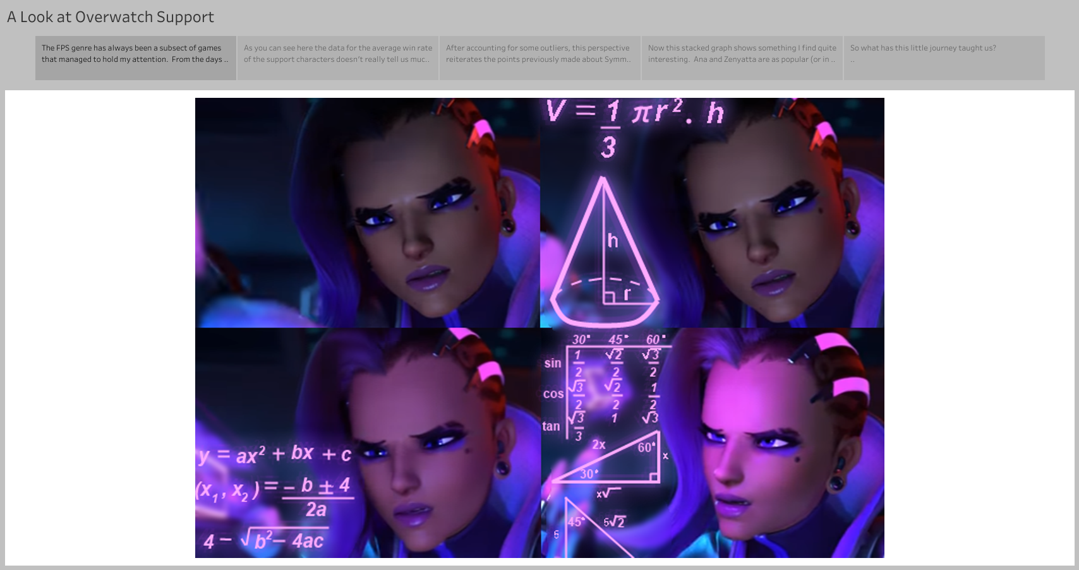

Slide 3
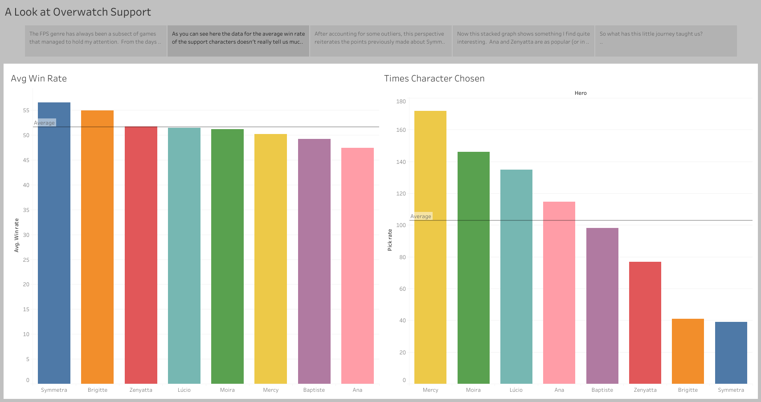

Slide 4
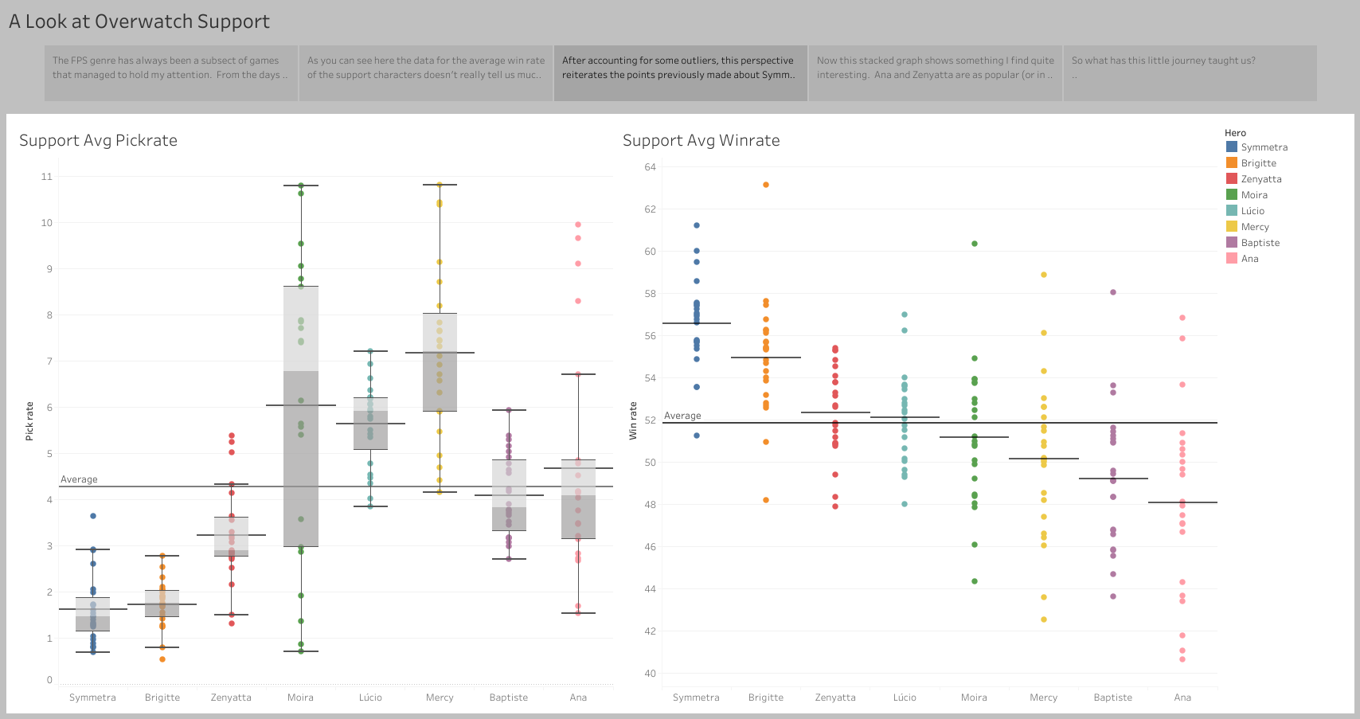

Slide 5
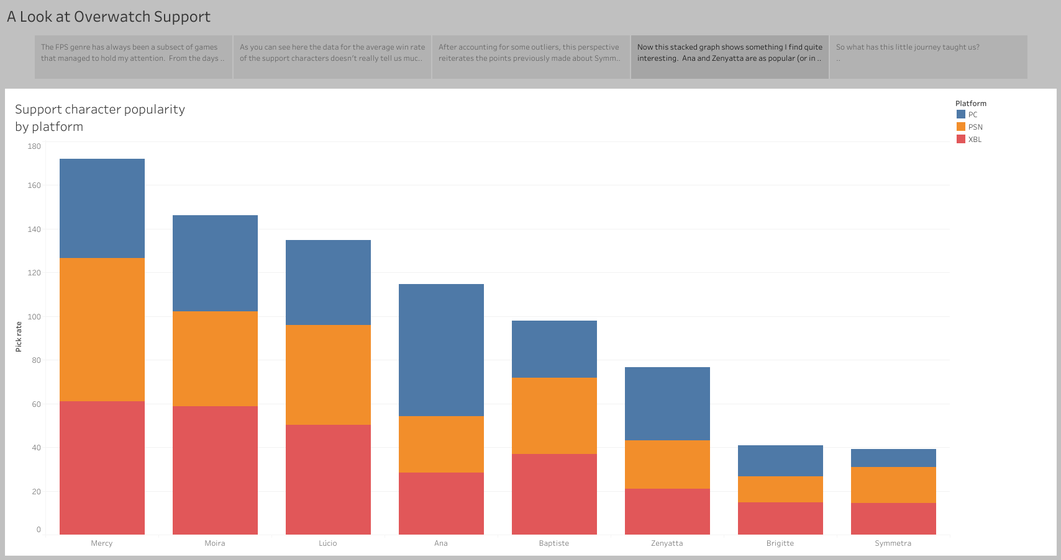

Slide 6
